Slide 1
Project 1 Presentation
Eric Hom
https://github.com/BigData2025-Rev/erichom-project1
January 13th, 2025

Slide 2
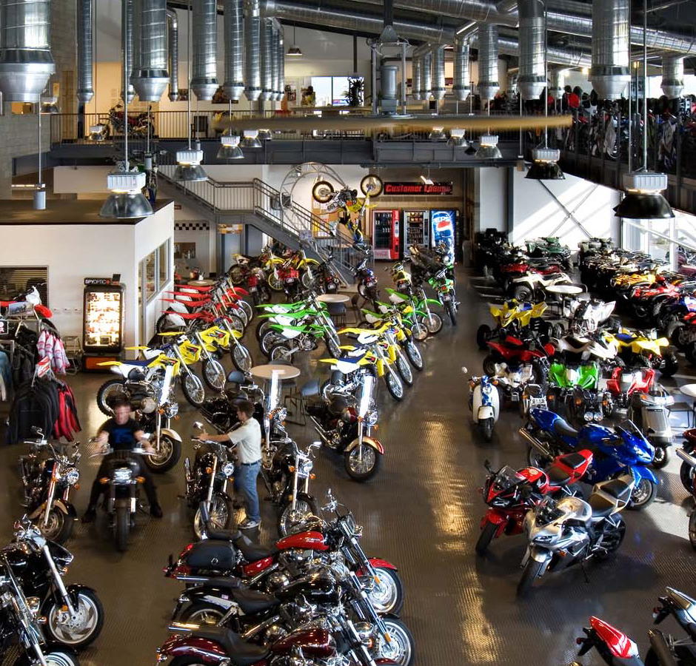
P1- Motorcycle Shop
CLI application that models a motorcycle shop that sells various brands and types of motorcycles
Users are able to view products, order products, and view their own orders
Admins are able to add products, update product parameters, delete products, view all users, view all orders, delete users, and grant admin access to users

Slide 3



Tech Stack
Python
mysql connector
tabulate
logging
MySQL
Git (github)

Slide 4
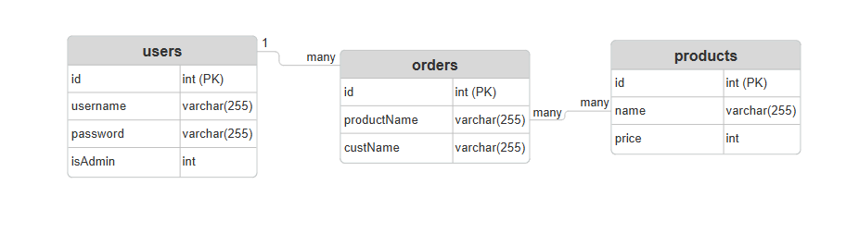
Entity Relationship Diagram

Slide 5

Demo

